Slide 1

Website Traffic Analysis using
Google Analytics
Structure
Introduction
Website screenshots Google Analytics overview Audience insights
Traffic sources Page performance User behavior
Improvements & conclusion
Ayyanar Digital Marketing
14/06/2026

Slide 2
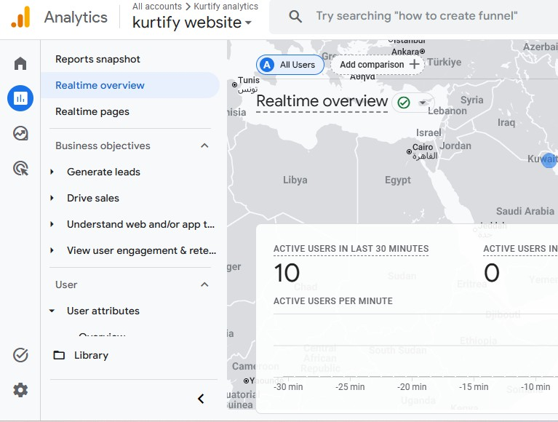
introduction
This project focuses on traffic
analysis of a 'Kurtify' using
fashion Google
website Analytics.
The objective is to understand user behavior, traffic sources, and website performance.

Slide 3


Website
Overview
The Kurtify website is designed to
showcase and sell screenshots include
kurtis.The homepage
and product pages.

Slide 4
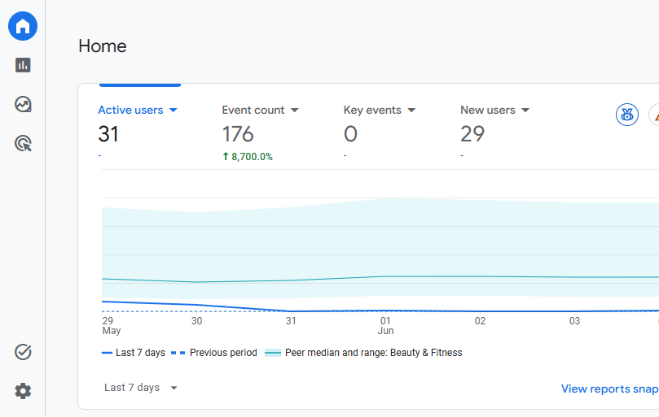
Google
Analytics
Overview
Google Analytics is used to track user activity and performance metrics.
The website received around 70 users, indicating initial traffic generation.

Slide 5
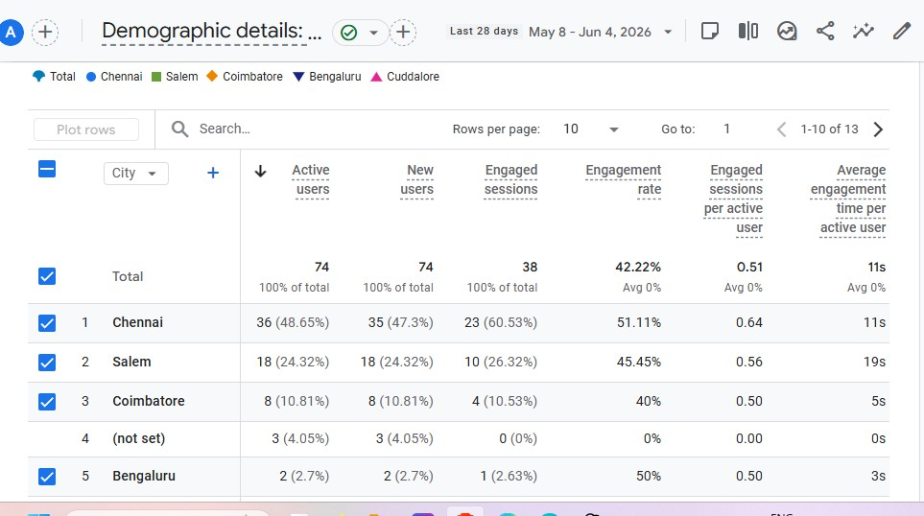
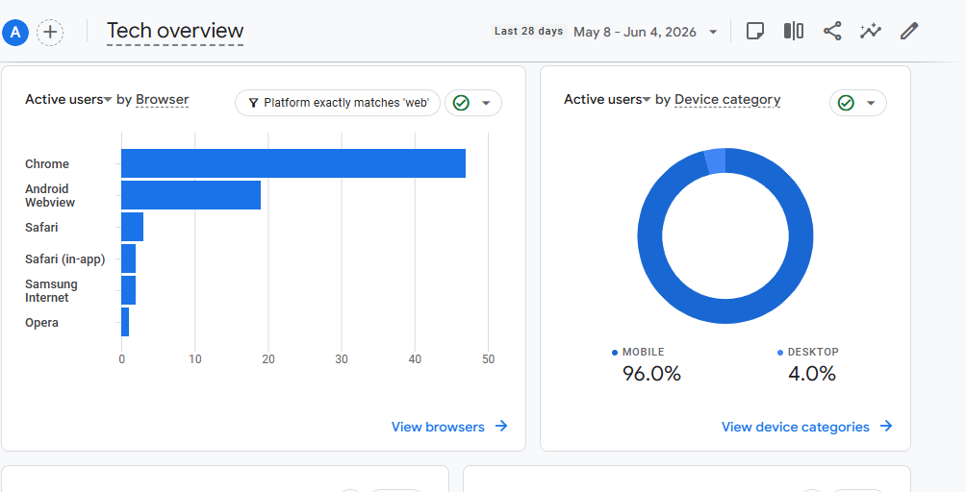
Audience
Insights
Analysis demographics user behavior.
of audience helps understand
Most users accessed via mobile devices, indicating mobile optimization importance

Slide 6
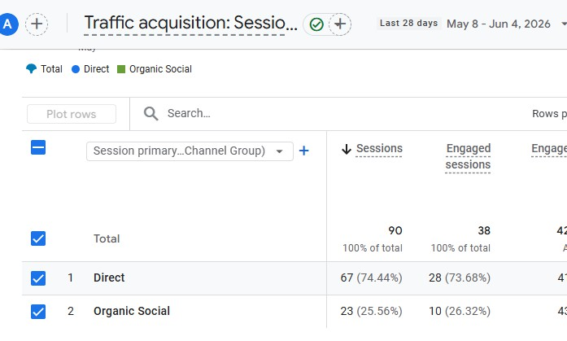
Traffic
Sources
Traffic sources show where users come from.
Major traffic is from direct and social channels.

Slide 7
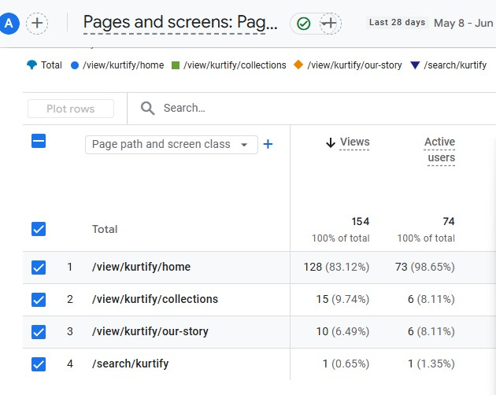
Page
Performance
Top-performing pages help identify popular content.
Home page recieved more engagement

Slide 8
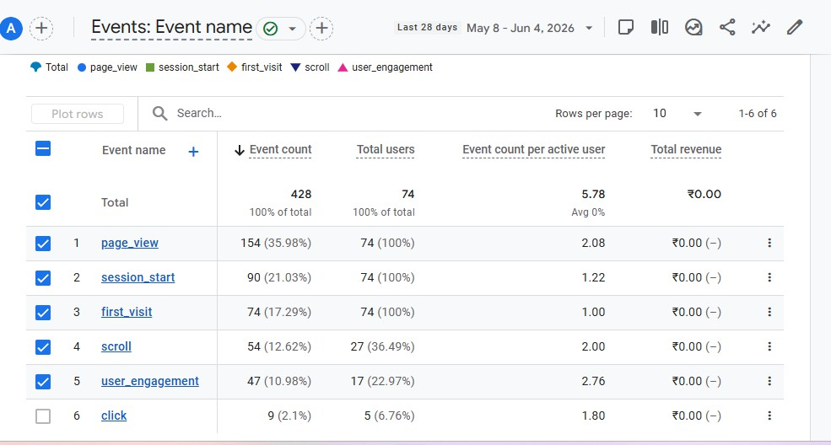
User
Engagement
User engagement metrics indicate how users interact with the website.
Session duration is moderate, but improvement is needed.

Slide 9
Improvements &
Recommendations
Improve SEO to increase organic traffic
Run Instagram ads for brand awareness
Optimize mobile user experience
Improve product descriptions and images
Add offers and discounts

Slide 10

Conclusion
The project demonstrates basic traffic analysis using Google Analytics and provides insights into improving website performance.
Thank YOU

